Slide 1
Informatica PowerCenter
Lesson 20: Row Error Logging

Slide 2
Lesson Objectives
In this Lesson you will learn about:
  Introduction to Row Error Logging
  Steps For Implementation

Slide 3
20.1. Introduction To Row Error Logging
During execution we can encounter two types of errors
  Critical Error/Fatal Errors – Which breaks the flow
  Non-Critical Error – Row level data errors
For Non-critical Row level data issues we can either Configure session property
1. Stop On Error =1 , which will break the flow and fail the session.
2. Error logging into flat file/DB tables

Slide 4
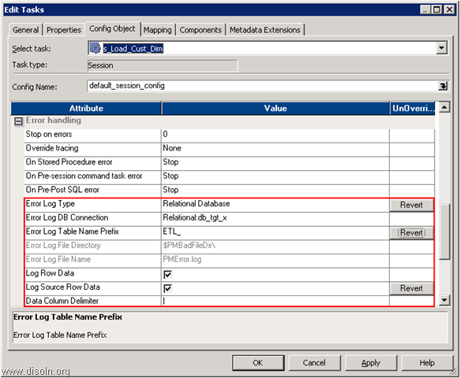
20.2. Steps For Implementing Row Error Logging
Steps for creating mapping following Constraint based loading
  Configure below session properties.
With this configuration, we are done with the setting required to capture any error during the session execution.
Notes:
Use this mapping when you do not you need to keep any previous versions / history of dimensions in the table.

Slide 5
20.2. Steps For Implementing Row Error Logging
Here is the details on what each property means.
Error Log Type :- Specifies the type of error log to create. It can be relational database or flat file.
Error Log DB Connection :- Database connection for a relational log.
Error Log Table Name Prefix :- Specifies the table name prefix for relational logs.
Log Row Data :- Specifies whether or not to log transformation row data.
Log Source Row Data :- Specifies whether or not to log source row data.
Data Column Delimiter :- Data will be delimited by the specified character in DB column.
With this configuration we specified, Informatica PowerCenter will create four different tables for error logging and the table details as below
ETL_PMERR_DATA :- Stores data about a transformation row error and its corresponding source row.
ETL_PMERR_MSG :- Stores metadata about an error and the error message.
ETL_PMERR_SESS :- Stores metadata about the session.
ETL_PMERR_TRANS :- Stores metadata about the source and transformation ports, when error occurs.
Notes:
Use this mapping when you do not you need to keep any previous versions / history of dimensions in the table.

Slide 6
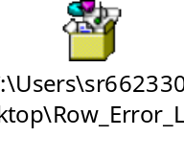
20.2. Steps For Retrieving Row Error Report
For Retrieving Error Records there are two ways
  Informatica Functionality –
Download the workflow wflw_To_Create_Files_For_Rejected_Records. Download the UNIX script splitfile.sh.
  Query the reject tables –
Attached is the query for your reference
Advantages
  Helps create error file with respect to each transformation within Informatica session.
  Helps you monitor any data quality issues.
  Helps in debugging any transformation errors in Informatica mappings.
  Helps you monitor the error records and provide corrections to existing ETL mapping to avoid these rejections on daily basis. This in turn will provide ongoing process improvements.
  Provides visibility to Business and IT Analysts about the bad data or incorrect business logic in ETL mappings.
Notes:
Use this mapping when you do not you need to keep any previous versions / history of dimensions in the table.

Slide 7
20.3. Advantage of Row Error Report
Advantages
  Helps create error file with respect to each transformation within Informatica session.
  Helps you monitor any data quality issues.
  Helps in debugging any transformation errors in Informatica mappings.
  Helps you monitor the error records and provide corrections to existing ETL mapping to avoid these rejections on daily basis. This in turn will provide ongoing process improvements.
  Provides visibility to Business and IT Analysts about the bad data or incorrect business logic in ETL mappings.
Notes:
Use this mapping when you do not you need to keep any previous versions / history of dimensions in the table.

Slide 8
Summary
This Lesson gives knowledge Row Error Logging , its implementation and advantages

Slide 9
Review Question
1. We have to create Error tables for Row Error logging ?
  No
  Yes
2. Error logging is done for
  Performance Gain
  Data Quality
Option A
Option B

